Slide 1

Local Government
Earlham High School Government II Class | March 19, 2015

Slide 2

Qualifications to be Mayor
  Live in city limits
  Eligible to vote (18 or older)
  Nomination petition (10 signatures)
  Affidavit of candidacy
  Nonpartisan election (majority wins)

Slide 3
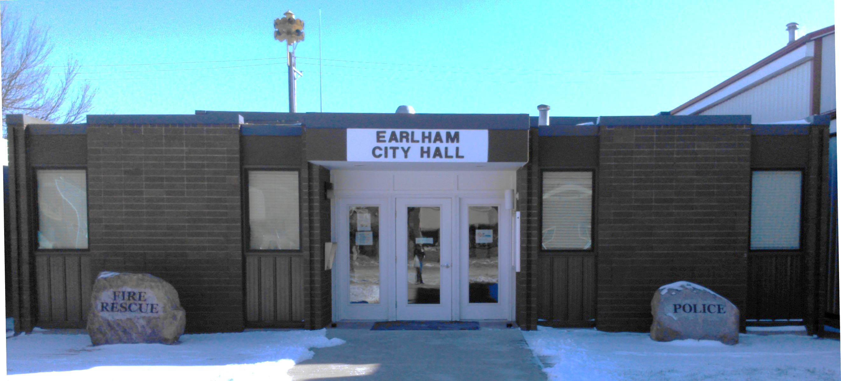
Becoming Mayor
  Election
  Oath of office
  Two-year term
  Begin in January following election
  $1,500/year + $25/ mo. expenses
  No vote on city council

Slide 4
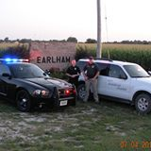
Duties of the Mayor
  Serve as Chief Executive Officer of City Departments
    Police Department
    Fire Department
    Public Works
    Library
    Parks & Recreation

Slide 5
Duties of the Mayor
  Preside over City Council meetings
  Sign checks from the City
  Public face and voice of our town
    Community gatherings, parades, etc.
    Receive complaints and ideas for making city better
    Protect the city’s image

Slide 6

Duties of the Mayor

Slide 7
Duties of the Mayor
  Make appointments
    Mayor Pro Tem (Jeff Lillie)
    Police Chief (Jason Heimdal)
    Fire Chief (Shawn Boyle)
    Rescue Captain (David Hopp)
    Library Board of Trustees
    Parks and Recreation Board
    Community Center Board

Slide 8
City Budget Overview
  Fiscal year: July 1 – June 30
  Revenue: $2.4 Million
  Expenditures: $2.3 Million
  Ending balance: $758,000
  Millage Rate: $12.00 per $1,000

Slide 9
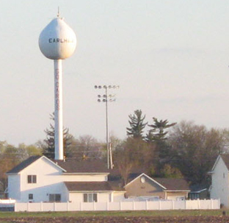
City Budget – Revenue Sources
  Property tax levies
  Other city taxes, fees, special assessments
  Charges for Utility Services
  Intergovernmental

Slide 10

City Budget – Levy rates

Slide 11
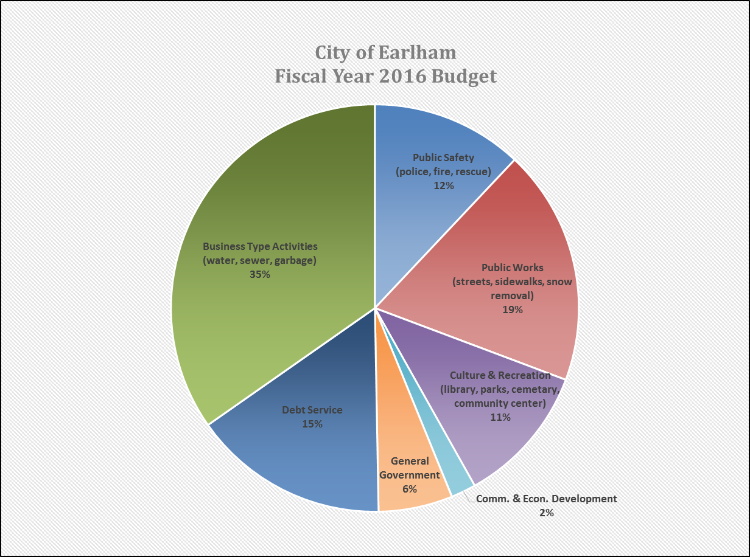
City Budget – Expenditures

Slide 12
Earlham Accomplishments in 2012
Refinanced the city’s long-term debt to save $628,453 and trim six years of payments
Created and updated job descriptions and initiated annual performance evaluations for all full-time city employees
Launched a redesigned city website and online bill pay service
Completed a Community Infrastructure Program to evaluate infrastructure needs and efficiently allocate funds to address those needs
Enacted a new noise ordinance within the city limits to help keep the peace
Revised the police department schedule to maximize hours on duty and provide coverage during high priority times
Contracted a new vendor for solid waste management services with improved customer service
Hired two city employees: Utility Billing Clerk and Public Works Assistant
Purchased a new snowplow truck and police cruiser
Extended a sewer main to the south side of town and completed a water main project
Began biweekly column in newspaper on city business

Slide 13
Earlham Accomplishments in 2013
Hired two city employees: Police Officer, Public Works Assistant
Created City of Earlham Facebook page
Installed in-dash cameras in the police vehicles and officer lapel cameras
Adopted City of Earlham Emergency Operations Plan to prepare for and respond to both natural and manmade disasters
Adopted Official Policies for the Earlham City Council to provide transparent and consistent policies for conducting business and a code of conduct for elected officials
Parking ordinance for business district to balance customers and residents

Slide 14
Earlham Accomplishments in 2014
Hired two city employees: Police Officer, Public Works Assistant
Completed interior remodel of City Hall to update and make more efficient use of the space
Completed downtown sidewalk and curb replacement project using tax increment financing (TIF)
Awarded two Community Development Block Grants (CDBG)
  $191,000 for water line replacement (requires $193,850 local match)
  $205,500 for housing grants (requires $15,000 local match). SICOG will assist with administering the housing grant program.
Madison County Chamber received an Iowa Great Places designation/award in 2014
  Includes John Wayne Birthplace Trail – map and plaque designations including Earlham sites
Installed laptop computers in police vehicles and upgraded police report software
Approved increase in compensation for mayor and city council
Replaced the roof on the Earlham Public Library and old jail building

Slide 15
Why Should you care?
Government impacts your life each & every day:
  Financially: taxes, fees, tuition, grants/loans
  Quality of life: health care, food, transportation
  Livelihood: jobs, minimum wage, workplace safety
  Laws/regulations: smoking, seat belts, business regulations
What kind of service do you expect?
What type of community do you want to live in?

